Slide 1
Unit-2

Slide 2
MONTE-CARLO TECHNIQUE OR MONTE-CARLO SIMULATION
A Monte Carlo simulation is a mathematical technique which predicts possible outcomes of an uncertain event. In this technique we use computer programs to analyze past data and predict a range of future outcomes based on a action. It is a technique used to understand the impact of risk and uncertainty.
In this method we use a probability distribution and find the different outcomes form a normal distribution ,where the most common outcome is in the middle of the curve.

Slide 3
Examples of monte Carlo simulation
For example, we find out the average height of the Nepal population. It is difficult, but not impossible, to determine the height of 3 crores (approximately) people. In such cases, different group in different region would gather height details from selected samples to find out the average height.
If surveyors collect samples of tall or short people , it will not give correct results. Hence ,for the correct data would be obtained only through fair sample selection using a probability distribution.

Slide 4
Applications
Risk Assessment: Monte Carlo simulations are used to evaluate risks in financial portfolios, project management, and insurance.
Engineering: Applied in reliability analysis, structural design, and optimization problems.
Physics: Used in particle physics, thermodynamics, and statistical mechanics for solving integral equations and modelling physical systems.
Game Theory and AI: Monte Carlo Tree Search (MCTS) is a decision-making algorithm that uses this method for optimal moves in games.
Medicine: Modelling the spread of diseases, radiation therapy planning, and drug development.

Slide 5
Advantages
Flexibility: Applicable to a wide range of problems across disciplines.
Scalability: Can handle large and complex models with many variables.
Probabilistic Insights: Provides statistical insights into the variability and uncertainty of outcomes.

Slide 6
The Monte-Carlo simulation procedure can be summarized in the following in the following six steps.
Step-1: Clearly define the problem.
a).Identify the objectives of the problem.
b).Identify the main factor which have the greatest effect on the objectives of the problem.

Slide 7
Step2:Construct an appropriate model
a)Specify the variables and parameters of model.
b).State the conditions under which the experiments is to be performed.
c)Define the relationship between the variables and parameter.
Step 3:Prepare the model for experiment.
a)Define the starting conditions for the simulation.
b)Specify the number of runs of simulation to made.

Slide 8
Step 4: Using step1 to step 3, experiment with the model.
a).Define a coding system that will corelate the factors define in step 1 with the random numbers to be generated for the simulation.
b).Select a random number generator and create the random no. to be used in the simulation.
c).Associate the generated random numbers with the factors identified in step 1 and coded in the step 4(a).

Slide 9
Monte Carlo Method vs Stochastic Simulation
Both Monte Carlo Method and Stochastic Simulation are widely used in fields such as finance, engineering, and operations research, among others, for modeling uncertainty and randomness. Although they are closely related and often overlap, there are key differences between the two.

Slide 10
1. Definition:
Monte Carlo Method:
  The Monte Carlo method is a specific class of algorithms that rely on repeated random sampling to obtain numerical results. It is mainly used to estimate complex mathematical problems that are difficult to solve analytically, such as calculating integrals, optimizing systems, and simulating random processes.
  Example: Estimating the value of Pi by randomly generating points inside a square and counting how many fall within a circle.
Stochastic Simulation:
  Stochastic simulation refers to any simulation that incorporates random variables and processes to model systems that exhibit inherent randomness or uncertainty. It simulates the evolution of a system over time, where variables evolve according to probabilistic rules.
  Stochastic simulation can encompass various techniques, including Monte Carlo methods, but also includes other simulation methods that deal with random processes, such as Markov Chains, Discrete Event Simulation (DES), or Agent-Based Modeling.

Slide 11
. Purpose and Application:
Monte Carlo Method:
  Primarily used for numerical estimation and probability distribution estimation.
  Applied in fields such as:
    Finance (e.g., pricing options, risk analysis).
    Physics (e.g., particle interactions).
    Optimization (e.g., Monte Carlo Tree Search in AI).
    Statistics (e.g., integration, sampling from distributions).
  It focuses on solving problems by performing random sampling from a distribution and then using those samples to approximate a result.
Stochastic Simulation:
  Used to simulate the behavior of systems that evolve over time with uncertainty.
  Applied in areas like:
    Operations Research (e.g., queuing systems, supply chain models).
    Healthcare (e.g., patient flow simulations, disease spread models).
    Engineering (e.g., modeling reliability of systems, maintenance schedules).
  Focuses on the dynamic behavior of a system over time, where the system is influenced by random inputs and processes.

Slide 12
3. Nature of Randomness:
Monte Carlo Method:
  Involves random sampling from a probability distribution to estimate the solution to a problem.
  It typically focuses on finding numerical solutions to problems that involve uncertainty, such as integrals or probabilistic outcomes.
Stochastic Simulation:
  Deals with random processes and time evolution of a system where the system's future state depends on current and past states, influenced by randomness.
  A stochastic simulation might model things like the state of a manufacturing system over time, or the spread of a disease, with random events affecting its dynamics.

Slide 13
Techniques Used:
Monte Carlo Method:
  Random sampling of variables to approximate a result.
  Involves large numbers of simulations to get statistical estimates (e.g., confidence intervals, expected values).
  Examples of Monte Carlo techniques include:
    Monte Carlo Integration
    Monte Carlo Tree Search
    Markov Chain Monte Carlo (MCMC)
Stochastic Simulation:
  Uses random processes or random variables to model the evolution of systems over time.
  Includes techniques such as:
    Discrete Event Simulation (DES) — Modeling systems as a sequence of events that occur at discrete points in time.
    Markov Processes — Systems where the future state depends only on the current state and not on the previous states.
    Queuing Models — Used in operations research for modeling waiting lines.

Slide 14
Feature | Monte Carlo Method | Stochastic Simulation
Scope | Primarily for estimating numerical solutions using random sampling. | Simulates the evolution of systems over time, modeling randomness in processes.
Focus | Numerical estimation, probabilistic integration, optimization. | Modeling dynamic systems with random behavior over time.
Application | Risk analysis, optimization, physics, numerical estimation. | Operations research, healthcare modeling, reliability, disease spread.
Techniques | Monte Carlo integration, Monte Carlo tree search, MCMC. | Discrete Event Simulation, Markov processes, Queuing theory.
Time Dependency | Often doesn't account for the time evolution of systems. | Explicitly models the evolution of systems over time.
Randomness Model | Random sampling from a distribution. | Stochastic processes, often with time-dependent variables.

Slide 15
6. Example Use Case:
Monte Carlo Method:
  Risk Assessment in Finance:
    Use Monte Carlo simulations to model the potential future prices of a stock by simulating random price movements based on known probability distributions (e.g., geometric Brownian motion).
Stochastic Simulation:
  Healthcare System Simulation:
    Simulate the flow of patients through a hospital's emergency department, where the arrival times of patients, service times, and resource availability are modeled as stochastic processes.

Slide 16
Step 5:Summarize the examine the results obtained in (4).
Step 6: Evaluate the results of the simulation.

Slide 17
Using Monte Carlo simulation to Estimate Value of “π”
Consider a unit square (with area one).
Inscribe in square a circle with radius ½ (with area πr2 = π/4).
Suppose we toss darts randomly at the square.
The probability that a particular dart will land in the inscribe circle is obviously π/4 (the ration of the two areas).
We can use this fact to estimate π.

Slide 18
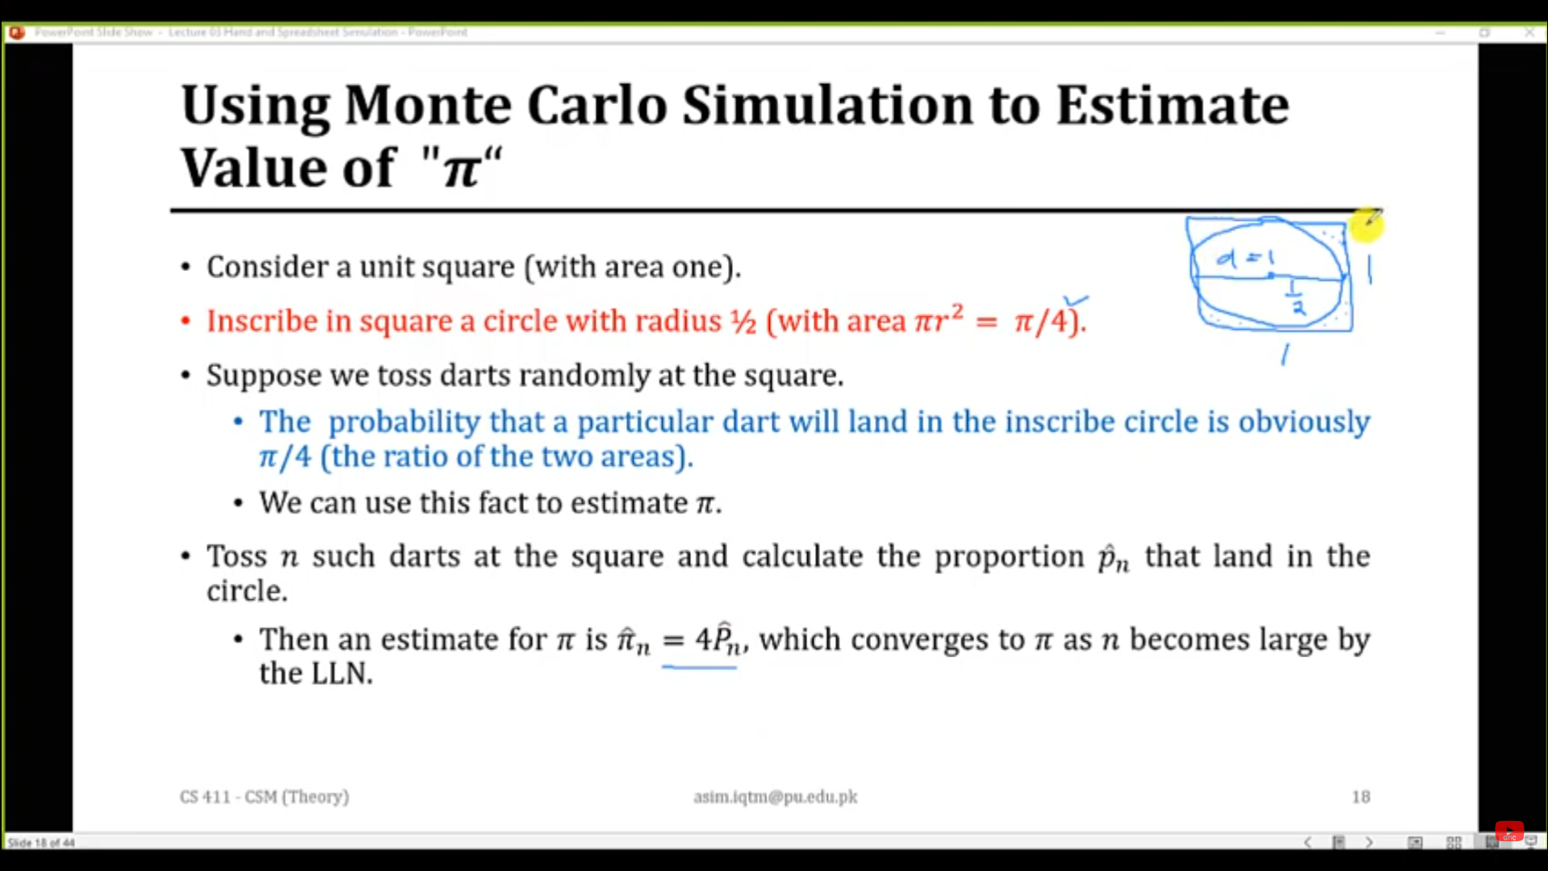
Toss n darts at the square and calculate the proportion p

Slide 19
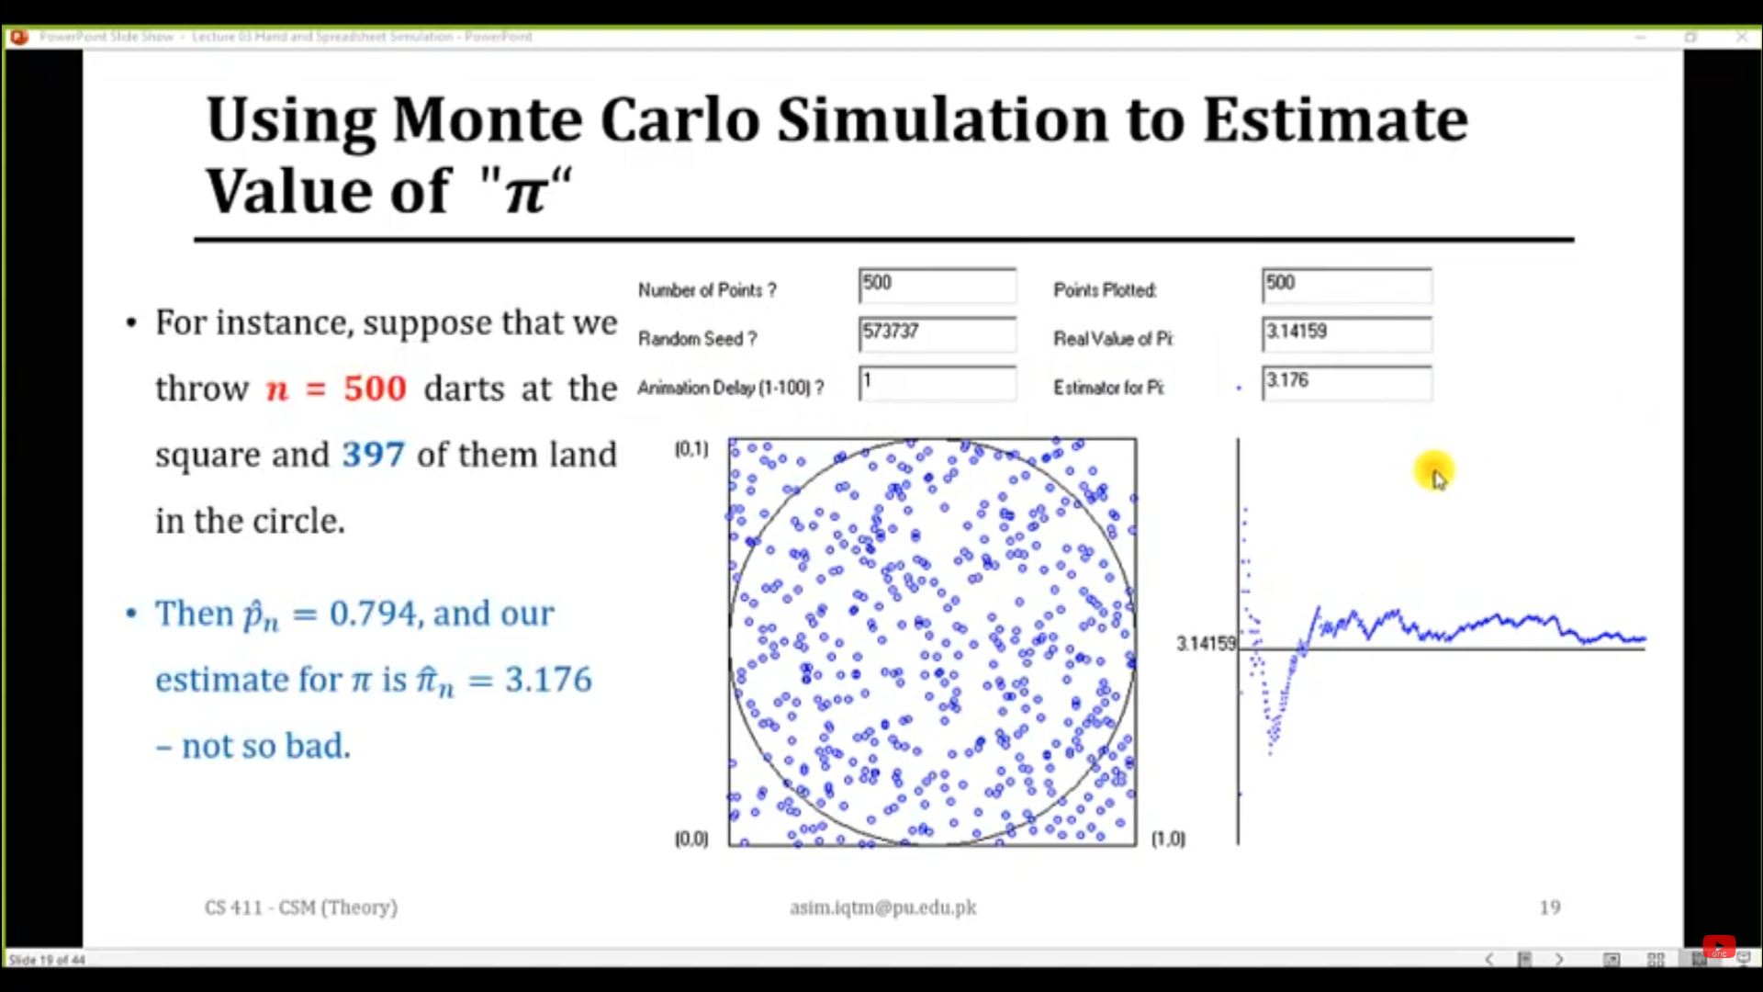

Slide 20
Definition: A probability distribution where data clusters around the mean, forming a symmetric bell-shaped curve.
Key Properties:
Mean (𝜇μ): The central point
.Standard Deviation (𝜎σ): Measures the spread of the data.
Approximately 68% of data lies within 𝜇±, 95% within μ±2σ, and 99.7% within 𝜇±3𝜎 (Empirical Rule).

Slide 21
Applications
Statistics: Modeling real-world data like heights, test scores, or measurement errors.
Machine Learning: Feature generation, sampling in algorithms like Monte Carlo methods.
Physics and Natural Sciences: Simulating noise and measurement uncertainties.
Finance: Stock market modeling and risk assessments.

